Slide 1
Data Watch
Presenter Information
Jason Puncher and François Tétreault
Date
Dec 13, 2016

Slide 2
Overview
Goal of the techniques discussed in this presentation is to catch invalid memory accesses (read or write) whilst minimizing the impact on both the CPU and memory.
“Catching the invalid access in the act.”
Keeping in mind the limitations of ours embedded systems:
All are PowerPC-based
All are 32 bit.
File system is either a small flash disk or a tiny ROM
RAM and CPU is limited
i.e. some targets only have 64 MB of RAM

Slide 3
Problem Summary
Software may intentionally or unintentionally access memory (e.g. read or write) that it shouldn’t.
NULL pointer dereference, access beyond array scope, or continued access of released memory.
Many tools exists to catch these types of accesses. But most catch it after the fact. And even few support latent memory access.
Some tools exist that to catch software in the act.
Valgrind : This tool simulates every instruction the program executes, adding instrumentation to every memory access, and every value computed. Though it will catch the access, it means simulating every instruction (plus instrumentation) resulting in significant runtime performance impact (10-50 times slower execution).
Electic Fence: Not so much a tool as a technique which requires rounding the number of bytes allocated to the nearest page size. This would have a significant memory impact in software which allocates many small blocks on a system with large page sizes.

Slide 4
Overview
Data Watch will track all accesses to memory allocated from the heap.
It can detect some stack overwrite conditions, memory block "out-of-bounds" access and latent read-write to previously freed memory.
Violations such as these often result in abnormal system behaviors that can be very hard to debug because the effects are unpredictable and can manifest in ways completely unrelated to the affected sub-systems or code.

Slide 5
Address Watchpoints (inspiration…)
block = allocator(size,…)
block == 0xFFFFFFFFA092600
block = add_watchpoint(block, <meta-data>)
block == 0x7654FFFFA092600
Inspired by presentation from Peter Goodman, a student from the University of Toronto (in May 2014).
Reference material can be found here:
https://ahls.dorsal.polymtl.ca/system/files/AHLS%20-%20Address%20Watchpoints-%20Instrument%20Data%2C%20Not%20Code.pdf
Taint object addresses so that accesses to "interesting" objects always raise a fault.
"Address watchpoints“
Relies on x86-64 48-bit address implementation in which 16 bits are "free" to be changed.
<meta-data>

Slide 6
Address Watchpoints (continued…)
Application
Tainted
Memory
Exception
Real
Memory
Access to tainted memory will generate and exception.
The exception handler would then strip the 16 bit taint from the address line and follow through with the access to physical memory.
Problem: How do we taint the address on a 32 bit system?
We do so by mapping the physical memory to a virtual memory region not mapped by the hardware MMU.
In essence, we are creating a software MMU. However, we are not limited by the page size, or having to align the physical address to a page boundary.

Slide 7
Working with 32-bit applications
Virtual Address
Space
Physical Address
Space
Carve up a large region of unmapped memory into equal sized blocks.
The memory allocator will :
allocate both a physical block of memory as well as one of these virtual blocks.
update a table mapping the virtual block address to its physical memory. The table will also include the allocation size.
return the pointer to the virtual address.
The pointer is now tainted. All accesses through this pointer will cause an exception, allowing the tool to sanitize the access.
If sane, the tool will map the virtual address back to the phyiscal memory and perform the read/write.
Memory Block A
Block D
Memory Block B
Block B
Return
these
addresses
Block C
Memory Block C
Memory Block D
Block A

Slide 8
Working with 32-bit applications (continued)
Virtual Address
Space
The limitation to this approach is that the tool can only track allocations whose size is smaller than the virtual block size.
For this reason we create multiple regions of varying block sizes.
In our system unmapped memory far exceeds the amount of physical memory. As such, with this approach we are able to create enough regions to cover all memory allocations.
Block 1
Region 1
Blocks of
same size
(i.e. 512 bytes)
Block n
Block 1
Region 2
Blocks of
same size
(i.e. 4KBytes)
Block m

Slide 9
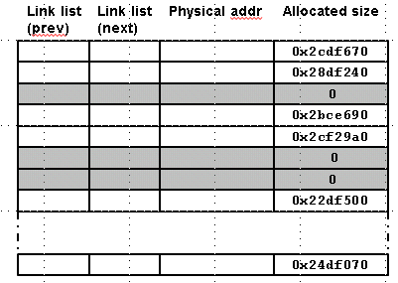
Tool Memory Allocation and Management
A table is maintained to map the block index back to its physical address.
Each entry having :
dual link list pointers to easily access both the free list, and allocation list
physical address for each block (after allocation)
the size of the memory allocation
Elements are pulled from the free list using FIFO. It’s a best effort way to ensure recently freed blocks are not re-used immediately.
A mapping table is created for each region.
Link list
(prev)
Link list
(next)
Physical addr
Allocated size
Free List [head]
0x2cdf670
Allocated List [head]
0x28df240
0
0x2bce690
0x2cf29a0
0
0
0x22df500
0x24df070
Table for region 1
(for blk of size X)
Table for region 2
(for blk of size Y)

Slide 10
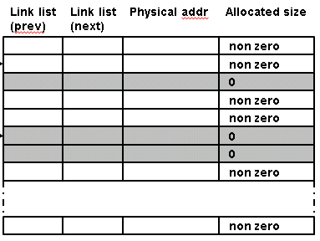
Tool Memory Allocation and Management (continued…)
In our system it’s possible to carve off a 128/256 MB (aligned) blocks of virtual memory. The starting address of this block is our base.
In it we create equal sized regions (the number of which must be a power of 2).
We then carve each region into blocks (the size of which must also be a power of 2).
This allows us to quickly determine which region we are accessing and which block (within the region) based on the bits in the address.
32 bit Virtual Address
Region
Number
[0-X]
Block number
[(X+1)- Y]
Offset Into Block
[(Y+1)-31]
BASE
Block Index
Region Index
Table for region 1
(for blk of size X)
Table for region 2
(for blk of size Y)
32 bit Physical Address + Offset

Slide 11
Runtime Execution
Exception Table
text
Access to a virtual address generates a Data Access Exception (DSI).
Exception handler calculates block index, and offset into block.
Block index is used to locate metadata. With it,
it can determine if the offset is greater than the allocated size.
or if the block is still allocated.
optionally, the memory could be pre-filled with a know pattern to see if we have a read before right access.
map the block + offset to the physical address
Log Error or trap if address is invalid.
The exception handler must then emulate the load/store using the physical address.
instruction
PC
stw xx
Data Access
Our Memory Access Validation Code
instruction
instruction
…
Translate Virtual to
Physical address
Addr. valid?
size != 0
offset < size
True
False
Log error or trap
Emulate mem access
Return from interrupt

Slide 12
Other applications
This tool has been expanded to support:
Stack linkage scribbler detection
Watch specific memory address range
Read before Write detection
Memory Utilization Tracking
Static Memory Overruns

Slide 13
Where to next?
Currently working on porting to Linux OS.
Add support for ARM processor.
Add support for static (data/bss) memory overruns. This would require compile modifications.

Slide 14
Thank You

